Slide 1


Newsflash
12th September 2025
Summer Reading Challenge – Celebration Assembly
The Summer Reading Challenge is still live until 30th September. We are so proud of all the children who have taken part this year!
To celebrate their achievements, we will be inviting children to bring in and share their certificates in our Celebration Assembly on Friday 3rd October.
If your child has completed the challenge, please ensure they bring their certificate into school by this date so we can celebrate together. Thank you for your support with this.
Christmas Cards
Christmas is fast approaching and it’s time for our annual Christmas Card Fundraising Project!
Please click HERE for further information
Click here for Crossing Patrol Update Letter
Looking for Holiday Helpers!
We’re looking for people to help out around the school during the upcoming holidays with jobs like cleaning, painting, and general maintenance.
This is a paid opportunity, perfect for anyone looking to earn a bit extra while supporting our school community.
If you’re interested or would like more details, please email us at office@sandcross.school
Please could any harvest donations be dropped into school on Thursday 25th September.
We will have buckets available on the playground at both drop-off and pick-up times. Children are also welcome to bring their donations into school and drop them off once they are inside.
Thank you very much for your support with this.
Wk/beginning 15th September PE Kit
Reception - Wednesday & Friday
Year 1 - Tuesday & Wednesday
Year 2 - Tuesday & Wednesday
Year 3 - Tuesday & Thursday
Year 4 - Tuesday & Thursday (no PE Tuesday for Mersey & Wye as it is Roman Day - see letter for details)
Year 5 - Monday & Friday
Year 6 - Wednesday & Friday (swimming kit for Wednesday)

Slide 2
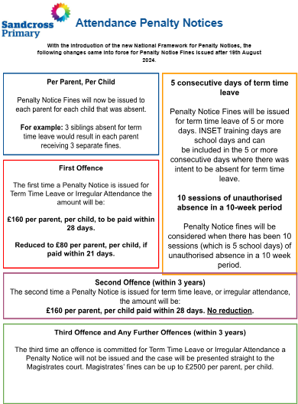
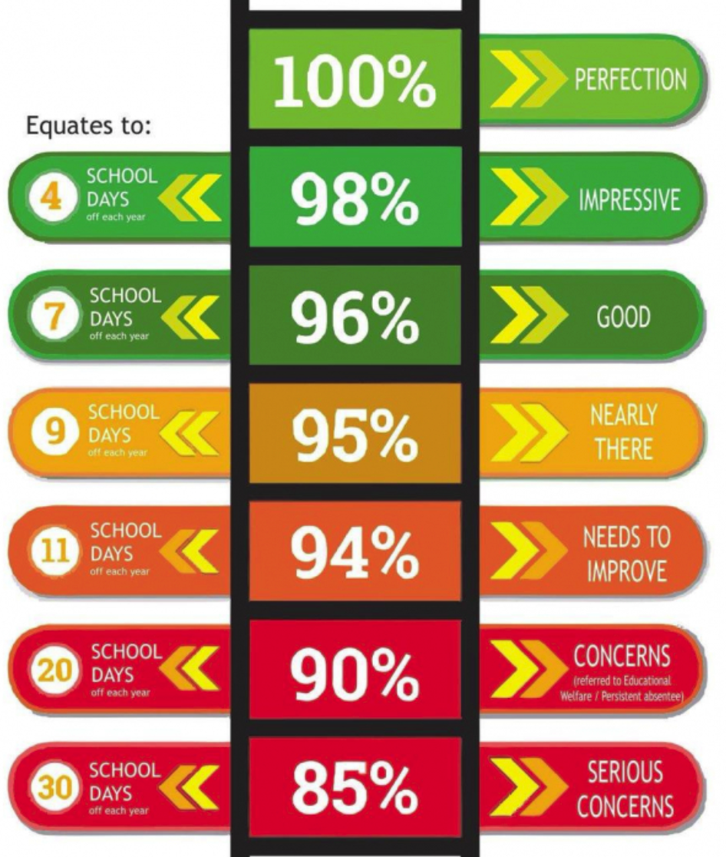
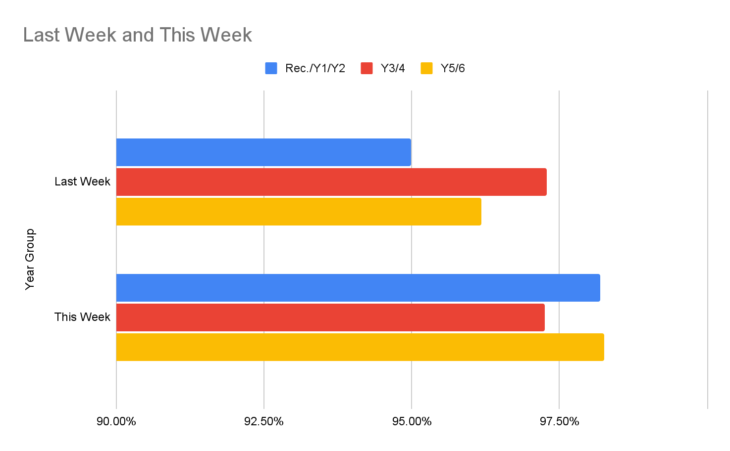

Newsflash
12th September 2025
Please click HERE to see a letter regarding attendance
← Extra Break Winners

Slide 3

Year 5
Key Dates
Year 6
Key Dates
Sunday 21st September
Come and visit Sandcross in the event village. We would love to see as many of our children signing up as possible - to register - please use this link:
https://www.runseries.co.uk/run-reigate-2025/
‘Team Sandcross’ will gather at the Sandcross stall at 11:30am for a team photo!
To join the official Sandcross team the code to enter is rh28hh

Slide 4
Thursday 18th September - Parent Rep Forum - 5pm Virtual only - Zoom Registration Link
Sunday 21st September - Run Reigate
Monday 22nd September - Clubs start - Letter
Thursday 2nd October - Harvest Festival Lunch - Form to order a lunch - HERE
Monday 6th October - Y3 Open Morning - Further details to follow
Thursday 9th October - EYFS Open Morning - Further details to follow
Monday 13th October - Parents Evening - Further details to follow
Thursday 16th October - Parents Evening - Further details to follow
Wednesday 5th & Monday 10th November - Flu Vaccinations - Letter
Monday 10th November - Y3 Open Evening - Further details to follow
Wednesday 19th November - EYFS Open Evening - Further details to follow
Monday 1st December - Year 3 Open Evening - Further details to follow
Wednesday 22nd - Friday 24th October - Inset Days
Monday 27th October - Friday 31st October - Half Term
Monday 3rd November - Inset Day
Monday 6th July - Sports Day - Nursery, Reception (am) Year 1 and Year 2 (pm)
Friday 10th July - Sports Day - Year 3, 4 (am) 5 and 6 (pm)
Whole School Dates
Click HERE to see the term dates for 2025-2026
All dates in red are new additions
All dates in blue have already been sent out

Slide 5
Nursery
Key Dates
Trips/Events 25/26 Summary - Letter
Thursday 9th October- Early Years Teddy Bears Picnic
Tuesday 9th December - Nursery Christmas Performance - Time to follow
Half Termly Newsletter
In Nursery this week…..
We've reached the end of our first week in Ladybirds and I'm sure all of the children are ready for the weekend!
They have mostly approached this new experience with smiles and bravery, with those that have found separating from a parent, settling well eventually with lots of cuddles, reassurance and distraction techniques by our wonderful staff.
Mr Richards was astounded when he visited us on our first day and saw all of the children sitting attentively on the carpet enthralled by 'Lucky the Ladybird' (Mrs Darar's puppet friend).
We have been spending time playing alongside and interacting with the children this week, and have already started to get to know them and help them to confidently explore their new environment while negotiating any conflicts that may arise when sharing resources with such a large group of other children.
This will continue next week when we will also begin some small group activities and simple assessments to help us determine targets for all areas of development for each child.
Please do not hesitate to speak to me if you have any questions or concerns regarding your child. Communicating with each other is key to ensuring your child receives the tailored learning and care they require to feel successful, happy and confident during their time with us.
To finish just a few reminders-
1- If you have not yet brought in a pair of wellies for your child please do so. (If you do not have a pair let a member of the team know and we will find a spare pair for them and label them with their name)
2- Please ensure all jumpers, water bottles, snack boxes and lunch boxes are clearly labelled with your child's name.
3-If your child is staying for either the extra hour or extended wraparound care please let me know at drop off each morning.
4- Please do not send any food that may contain traces of nuts in either lunch boxes or snack boxes, we are a no nuts school and we do have a child with a nut allergy in Ladybirds this year.
5- Please ensure your child always has a change of clothes in their bag including : underwear, socks, a pair of leggings/tracksuit bottoms, a T Shirt and a jumper.
Thank you so much, have a wonderful weekend,
Ladybirds Team

Slide 6
Reception
Key Dates
Trips/Events 25/26 Summary - Letter
Tuesday 30th September - Reception Road Safety Day - Letter
Thursday 9th October- Early Years Teddy Bears Picnic
Wednesday 10th & Thursday 11th December - Reception, Year 1 and Year 2 Xmas Performance - Each mixed year group will perform twice – once in the morning and once in the afternoon – to ensure every child has the opportunity to perform at both times of day. Further details to follow
Half Termly Newsletter
In Reception this week…
The children have been amazing at continuing to learn and follow our new school rules and routines. We have been so impressed with how well they have settled into school life. We have been busy learning our friends names and all the different areas of our classrooms.
The children have also been introduced to the ‘Zones of Regulation’ which we use to help support them to communicate their thoughts and feelings. There are 4 different colours: Green (happy, calm ready to learn) Blue (sad, tired, bored or sick) Yellow (frustrated, excited, worried or shy) and Red (angry, terrified, hitting or yelling). We use these colours to help children to broaden their vocabulary and learn different strategies to help them return to green.
We have had a large amount of children arriving to school with rucksacks. As our cloakroom is very small with limited space, the children are often unable to reach their pegs or find their items. As this is stopping the children from being independent we are now asking for parents to please use bookbags going forward. As your child's learning develops, they will be bringing home reading books, library books and a homework folder which fit more easily into bookbags. We appreciate your support with this.
From Monday, we will begin using the children’s school planners as our main point of communication with you. If we have any messages about your child’s day at school e.g. lost items or toileting accidents, we will now write them in their planner. It is vital that your child brings their planner to school each day in the plastic reading folder.
A few little reminders, if you have not already brought a pair of named wellies in for your child to keep at school, we are now asking for them to brought by next Friday. Please also ensure all their items are clearly named, including water bottles.
We hope you have a wonderful weekend.
The Reception Team

Slide 7
Year One
Key Dates
Trips/Events 25/26 Summary - Letter
Tuesday 14th October - Y1 Trip to gatton Park - Letter to follow
Thursday 20th November - Y1 and Y2 Inspire Session - (parent can visit their child’s class and observe the learning)
Wednesday 10th & Thursday 11th December - Reception, Year 1 and Year 2 Xmas Performance - Each mixed year group will perform twice – once in the morning and once in the afternoon – to ensure every child has the opportunity to perform at both times of day. Further details to follow
Home learning letter - Letter
Year 1 Curriculum Evening Recording Passcode: h?&JKK27
Half Termly Newsletter
In Year 1 this week……
We are so proud of the way the children have settled into year 1! They are showing us that they already know the rules and routines, and we’ve seen some excellent examples of our school values.
Maths: In maths this week we have been practising writing and reading numbers as words. We have also practised our skill of counting backwards. Can the children show you their learning at home?
English: In English we have begun writing our books ‘All about us’. We have had a special focus on saying our sentences aloud before writing. We have also used finger spaces, capital letters and full stops to write effective sentences.
Science: In science we continued looking at animals as our topic this half term is Zany Zoologists. We have learnt how animals can be categorised into groups such as reptiles, mammals etc. We have compared the differences between the groups.
At home: We are sending home the children's reading folders with 2 books this week. They will have a Book bag book (larger book) which the children may not have read before. They will also bring a smaller phonics book home. This is a book that they will have read a few times over the week so it will be familiar, meaning it can be read with a greater level of independence. It is important for the children to read this book as many times as possible as it will improve their fluency. Please write in their reading diary when your child reads at home. Home learning will come home next Friday.
Reminders: The field will be open at lunchtime next week, please ensure your child has a named pair of wellies in school to enable them to enjoy this. We would also like to remind you that we are a nut-free school. Please ensure that your child has a coat in school so we are able to go outside during showers.
Thank you - Year 1 Team

Slide 8
Year Two
Key Dates
Trips/Events 25/26 Summary - Letter
Tuesday 23rd September - Y2 Great Fire of London Workshop in school - Letter
Thursday 20th November - Y1 and Y2 Inspire Session - (parent can visit their child’s class and observe the learning)
Wednesday 10th & Thursday 11th December - Reception, Year 1 and Year 2 Xmas Performance - Each mixed year group will perform twice – once in the morning and once in the afternoon – to ensure every child has the opportunity to perform at both times of day. Further details to follow
Home learning letter - Letter
Year 2 Curriculum Evening Recording Passcode: 1Y@kst#F
Half Termly Newsletter
Year Two
We have had a wonderfully productive week in Year 2!
Maths: This week, we have been working on recognising tens and ones in two-digit numbers. The children have used concrete resources (dienes), place value charts, and part-whole models to deepen their understanding of partitioning numbers. They have impressed us with their use of mathematical language such as part, whole, tens and ones.
English: In English, we have been focusing on grammar and sentence structure. The children have learned about the past progressive tense, how to use possessive apostrophes, and how to turn adjectives into adverbs by adding the suffix -ly. They used these skills to create sensational sentences, such as: People were screaming loudly in the streets. London’s houses were burning fiercely.
We also practised using commas to separate items in a list.
Science: In Science, we began exploring materials and their properties. The children enjoyed going on a classroom hunt to find objects made of wood, plastic, metal, and more. They then grouped these objects according to the material they were made from.
At home: Please continue practising reading at home as often as possible.Home learning has been sent home for the first time today. A reminder that all home learning should be returned to school by Wednesday. We will also be checking planners on Wednesday. Thank you, as always, for your support!
Reminders: We kindly ask that all children bring a pair of wellies to school so they can comfortably access the field. Please ensure that the wellies are clearly labelled with your child’s name. We would also be grateful if you could provide any spare underwear / socks or uniform that we can use as spares in school in case of accidents.
Thank you for your continued support and cooperation - Year 2 Team

Slide 9
Year Three
Key Dates
Friday 26th September - Y3 Inspire Session 9:15am & Coffee morning in the hall- (parent can visit their child’s class and observe the learning) - Letter
Tuesday 30th September - Stone age Day - Letter to follow
Tuesday 16th December - Year 3 and 4 at Reigate Baptist Church (1:30 pm)
Wednesday 4th March to Wednesday 20th - Swimming - Letter
Half Termly Newsletter
Year 3 have continued to impress us with their behaviour and positive attitude this week. They are showing resilience even though they are quite tired. I have been in all of the classrooms and the children have been telling me about their work on the Stone Age, and I have seen two classes enjoying reading The Stone Age Boy book during English lessons.
I have been outside with them at break times and lunchtimes and despite the changeable weather, they have been having fun with new friends, which has been lovely to see.
The soft start room that the staff have set up is proving popular with those children who are struggling with leaving parents in the mornings. We will continue to run this for as long as is necessary.
We look forward to seeing those of you who can make our INSPIRE session and coffee morning - it would be lovely if the children could bring some cakes in for this on the day before (the 25th September). Thank you very much in advance.

Slide 10
Year Four
Key Dates
Trips/Events 25/26 Summary - Letter
Tuesday 16th & Wednesday 17th September - Roman Britain Day - Letter
Monday 22nd September - Bowles residential information presentation 5:00 via zoom LETTER
Wednesday 24th September - 4 Wye Class Assembly
Wednesday 5th November - Year 4 Swimming starts
Thursday 13th November - Y4 9:15am Inspire Session - (parent can visit their child’s class and observe the learning)
Tuesday 16th December - Year 3 and 4 at Reigate Baptist Church (1:30 pm)
Wednesday 5th November to Wednesday 10th December and Wednesday 7th January to Wednesday 4th February - Swimming - Letter
Year 4 Curriculum Evening Recording Passcode: v33Rdu%1
Half Termly Newsletter
Year 4 have had a busy week and are now fully settle back into the swing of school.
We have been immersing ourselves in our new topic of The Romans, and I have seen children making human timelines, acting out scenes between the Celts and the Romans and generally enjoying their history lessons.
I have also seen children making models of teeth out of plasticine, therefore getting totally immersed in their science lessons.
We are looking forward to our Roman days next week. The children are welcome to dress as Romans for the day (4 Wye can wear the same costume for the Roman day and our assembly day).
We are also looking forward to starting our trumpet lessons next Monday (Mersey & Wye) - I have not heard 30 trumpets in the same room before, so it should be interesting. I will report back next week!
Thank you for encouraging the children with their reading at home - I have almost run out of stickers this week!

Slide 11
Year Five
Key Dates
Trips/Events 25/26 Summary - Letter
Thursday 18th September - Y5 Victorian Day in school - Letter
Thursday 9th October - Y5 Inspire Session 9:15am - (parent can visit their child’s class and observe the learning)
Monday 15th December - Year 5 and 6 at Reigate Baptist Church Xmas Performance (1:30 pm) Details to follow
Wednesday 3rd June to Wednesday 1st July - Swimming - Letter
Year 5 & 6 Curriculum Evening Recording Passcode: 1FbdG&ta
Half Termly Newsletter
Year 5 have had a fantastic week and the children have shown all of our Sandcross Values. In maths, we have recapped negative numbers and Roman numerals, along with key arithmetic skills, ready to begin our flexible maths groups next week.
During reading and writing lessons, we have been transported back to the Victorian era, via the tale of Jim Jarvis from 'Streetchild' by Berlie Doherty. We have been impressed by the empathetic way the children have discussed the events in this story. Our study of the Victorian era has continued in history lessons, where year 5 have been learning about the jobs Victorian children did. We're looking forward to our Victorian Day next week - dressing up for this is optional, but encouraged as it gives the best immersive experience.
Home learning will be set on Century this week. The children’s log ins will be stuck in to their planners.

Slide 12
Year Six
Key Dates
Trips/Events 25/26 Summary - Letter
Monday 15th September - 6 Franklin & 6 Beatles - Newhaven Fort trip - letter
Tuesday 16th September - 6 Marley & 6 Presley - Newhaven Fort trip - letter
Wednesday 17th September - Y6 Start Swimming - Letter - Please remember to send the children into school with their swimming kits.
W/B 29nd September - Year 6 tutoring starts (invited children only - letter to follow)
Thursday 2nd October - Y6 Inspire Session 9:15am- (parent can visit their child’s class and observe the learning)
Monday 15th December - Year 5 and 6 at Reigate Baptist Church (1:30 pm) Xmas Performance - Details to follow
June 2026 - IOW Residential - Letter
Year 5 & 6 Curriculum Evening Recording Passcode: 1FbdG&ta
Half Termly Newsletter
Year 6 Weekly Update:
Year 6 have had a busy week as we have been learning about the causes of World War 2. We have also been learning about the geography of Europe and comparing modern day Europe with occupied Europe during the war. In maths we have been consolidating our knowledge of place value and preparing for our flexible groupings, which will begin next week.
In English we have been editing and publishing our first piece of writing about a lost thing. We have working hard to improve our editing skills and ensure our presentation is of a high quality.
In Art, we have been completing inner and outer self portraits to show our interests and talents.
We are looking forward to our trip to Newhaven and our first swimming session next week. Please check the letters for information. Home learning will be set on Century this week. The children’s log ins will be stuck in to their planners.

Slide 13

Years 5 & 6 - Girls and Boys Football Team Trials
Following the trials this week, the ESE sports coaches have selected their football teams.
Those who have been successful and selected for the football teams will receive a confirmation email from the school office.
Your child will also be manually added to the football team on your schoolsbuddy account.
Please check your schoolsbuddy account next week and look out for your confirmation and payment reminder.
If you have any questions about the football teams or any other clubs please contact Becky at the school office or email clubs@sandcross.school
Year 5
Key Dates
Year 6
Key Dates
We are pleased to confirm that the Year 5/6 Choir will be taking part in the Young Voices concert at the O2 Arena on Tuesday 20th January 2026. This is an exciting opportunity for pupils to sing as part of a massed choir of around 9,000 children – a truly memorable experience.
All children who signed up for the choir this term have been allocated a place. Please note that preparation will require individual practice to learn the songs and words, so children should be ready to commit time to this at home.
On the day, we will leave school by minibus mid-morning, have lunch at the venue, and attend the afternoon rehearsal. The concert runs from 7:00 pm – 9:00 pm, after which we will return to school by minibus, arriving back at approximately 11:00 pm. Please note that even if you attend the concert, children must travel back with the school group.Please click the letter link below for further information.
Young Voices Letter

Slide 14

Harvest Festival Lunch
Thursday 2nd October 2025
Please complete this form to order a lunch Harvest Festival School Lunch Form
Year 5
Key Dates
Year 6
Key Dates

Slide 15

Year 5
Key Dates
Year 6
Key Dates

Slide 16

Year 5
Key Dates
Year 6
Key Dates

Slide 17

Year 5
Key Dates
Year 6
Key Dates

