Slide 1




Newsflash
5th September 2025
Sandcross Clubs
Please click here to read our Clubs Letter, which contains important information about club selections, start dates, and how to secure a place for your child. Clubs are managed through SchoolsBuddy. If you need help with your SchoolsBuddy login, please contact the school office.
Club selections will open on Monday at 9:00am.
From next week we will be opening our field zones. Please can all children bring a pair of wellies (NAMED) in a strong plastic bag so they can access the field throughout the year.
Whole School Photo
If you would like to purchase a whole school photo that was taken back in July please use this QR code to place your order.
Wk/beginning 8th September PE Days
Reception - Wednesday & Friday
Year 1 - Tuesday & Wednesday
Year 2 - Tuesday & Wednesday
Year 3 - Tuesday & Thursday
Year 4 - Tuesday & Thursday
Year 5 - Monday & Friday
Year 6 - Wednesday & Friday

Slide 2
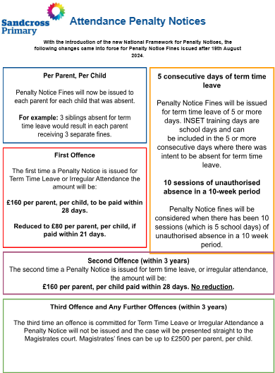
Newsflash
5th September 2025
Please click HERE to see a letter regarding attendance

Slide 3

Year 5
Key Dates
Year 6
Key Dates
Sunday 21st September
Come and visit Sandcross in the event village. We would love to see as many of our children signing up as possible - to register - please use this link:
https://www.runseries.co.uk/run-reigate-2025/
‘Team Sandcross’ will gather at the Sandcross stall at 11:30am for a team photo!

Slide 4
Whole School Dates
Thursday 18th September - Parent Rep Forum - 5pm Virtual only - Zoom Registration Link
Sunday 21st September - Run Reigate
Monday 22nd September - Clubs start - Letter
Thursday 2nd October - Harvest Festival Lunch - Form to order a lunch - HERE
Monday 6th October - Y3 Open Morning - Further details to follow
Thursday 9th October - EYFS Open Morning - Further details to follow
Monday 13th October - Parents Evening - Further details to follow
Thursday 16th October - Parents Evening - Further details to follow
Wednesday 5th & Monday 10th November - Flu Vaccinations - Letter
Monday 10th November - Y3 Open Evening - Further details to follow
Wednesday 19th November - EYFS Open Evening - Further details to follow
Monday 1st December - Year 3 Open Evening - Further details to follow
Wednesday 22nd - Friday 24th October - Inset Days
Monday 27th October - Friday 31st October - Half Term
Monday 3rd November - Inset Day
Monday 6th July - Sports Day - Nursery, Reception (am) Year 1 and Year 2 (pm)
Friday 10th July - Sports Day - Year 3, 4 (am) 5 and 6 (pm)
Click HERE to see the term dates for 2025-2026
All dates in red are new additions
All dates in blue have already been sent out

Slide 5
Nursery
Key Dates
Monday 8th September Group A - 8.30 - 11.30am. Group B - 12 - 3.00pm
Tuesday 9th September. Group B - 8.30 - 11.30am. Group A - 12 - 3.00pm
Wednesday 10th September - normal hours
Trips/Events 25/26 Summary - Letter
Tuesday 9th December - Nursery Christmas Performance - Time to follow
In Nursery this week…..
Good afternoon and welcome to the first weekly update message of this new year in Ladybirds.
Each week I will be updating you with what we have been learning along with any news or information you may need.
It has been lovely to meet with you all this week and see how excited all of the children are to be embarking on this new stage in their lives.
The team and I have also been busy getting the classroom ready for next week when the adventure begins!
A reminder of the starting sessions for Monday and Tuesday: Children in group A will attend the 8.30--11.30 session on Monday and the 12.00-3.00 session on Tuesday.
The children in group B will attend the 12.00-3.00 session on Monday and the 8.30-11.30 session on Tuesday.
All children will begin their normal hours on Wednesday with all wraparound care available.
We look forward to welcoming your child into our wonderful environment and helping them to become the confident, happy and independent learners we know they will be.
Have a lovely weekend.
Kind regards,
Mrs Darar and the Nursery team.

Slide 6
Reception
Key Dates
Monday 8th September: All chn in until 1pm.
Tuesday 9th September onwards : All children in from 8:40 - 3:15.
Trips/Events 25/26 Summary - Letter
Wednesday 10th & Thursday 11th December - Reception, Year 1 and Year 2 Xmas Performance - Each mixed year group will perform twice – once in the morning and once in the afternoon – to ensure every child has the opportunity to perform at both times of day. Further details to follow
In Reception this week…
Good afternoon,
This week we have loved meeting all of our new children on their home visits. We have enjoyed finding out about you all - thank you for all being so welcoming. Just a few reminders for next week:
Monday 8th September: All chn in until 1pm.
Tuesday 9th September onwards : All children in from 8:40 - 3:15.
Wednesday and Friday - PE Kits
Any questions, please speak to your child's class teacher.
We are so excited for the year ahead!
Best wishes,
The Reception Team

Slide 7
Year One
Key Dates
Monday 8th September - Year 1 Curriculum Information Session - 5:00pm - Virtual only - Zoom Registration Link
Wednesday 8th October - Y1 Trip to gatton Park - Letter to follow
Thursday 20th November - Y1 and Y2 Inspire Session - (parent can visit their child’s class and observe the learning)
Wednesday 10th & Thursday 11th December - Reception, Year 1 and Year 2 Xmas Performance - Each mixed year group will perform twice – once in the morning and once in the afternoon – to ensure every child has the opportunity to perform at both times of day. Further details to follow
In Year 1 this week……
We have had a fantastic first week in year 1! We have been learning about the rules and expectations in year 1 and have done an amazing job at following them!
Maths: In maths this week we have been practising our careful counting with numbers to 10 using manipulatives and pictorial representations to help us.
English: In English this week we have been learning about the features of a postcard and writing our own one all about what we did over the summer holidays.
Science: In science we started looking at animals as our topic this half term is Zany Zoologists. We created animals out of lego and looked at a range of animal books.
At home: We are sending home the children's new reading folders with 1 book this week. Please read with your child at home as often as possible and write in their reading diary as this helps support their learning in school.
Reminders: The field will be open at lunchtime next week, please ensure your child has a named pair of wellies in school to enable them to enjoy this.
Have a lovely weekend.

Slide 8
Year Two
Key Dates
Monday 8th September - Year 2 Curriculum Information Session - 5:30pm - Virtual only - Zoom Registration Link
Tuesday 23rd September - Y2 Great Fire of London Workshop in school - Letter
Thursday 20th November - Y1 and Y2 Inspire Session - (parent can visit their child’s class and observe the learning)
Wednesday 10th & Thursday 11th December - Reception, Year 1 and Year 2 Xmas Performance - Each mixed year group will perform twice – once in the morning and once in the afternoon – to ensure every child has the opportunity to perform at both times of day. Further details to follow
Year Two
Welcome back!
It has been wonderful to see the children bounce into class this week. They have been full of enthusiasm and energy and have quickly settled into the rhythm and routine of being back at school.
In PSHE, we have revisited the Zones of Regulation and our school values, discussing how important these are in helping us both in school and at home.
In English, we introduced the book Vlad and the Great Fire of London. Perhaps the children can tell you who Vlad and Boxton are! This has led us into our history learning, where we began investigating the Great Fire of London and comparing what London was like in the past to what it is like today.
Planners and reading books have been sent home today, and home learning will begin next week.
The children have had a fantastic first week in Year 2 – we are very proud of them!
Best wishes,
The Year 2 Team

Slide 9
Year Three
Key Dates
Friday 26th September - Y3 Inspire Session 9:15am & Coffee morning in the hall- (parent can visit their child’s class and observe the learning)
Tuesday 30th September - Stone age Day - Letter to follow
Tuesday 16th December - Year 3 and 4 at Reigate Baptist Church (1:30 pm)
What a confident start Year 3 have made this week!
I have been so impressed with their enthusiasm, positivity, and attitude towards learning, as well as their excellent playground behaviour. Many adults have commented on how settled they have been—from the moment they arrive in the morning to the time they leave at the end of the day.
I have visited each classroom this week, and the children have been eager to share their work and talk enthusiastically about their learning. We have already enjoyed two assemblies together, where they showed a clear understanding of our school values and spoke with excitement about their new friendships.
Year 3 have made such a fantastic start, and I am really looking forward to the year ahead with them.

Slide 10
Year Four
Key Dates
Tuesday 9th September - Y4 Curriculum Information Session: Virtual Only - 5pm - Zoom Registration Link
Trips/Events 25/26 Summary - Letter
Tuesday 16th & Wednesday 17th September - Roman Britain Day - Letter
Monday 22nd September - Bowles residential information presentation 5:00 via zoom LETTER
Wednesday 24th September - 4 Wye Class Assembly
Wednesday 5th November - Year 4 Swimming starts
Thursday 13th November - Y4 9:15am Inspire Session - (parent can visit their child’s class and observe the learning)
Tuesday 16th December - Year 3 and 4 at Reigate Baptist Church (1:30 pm)
What an incredible start to Year 4!
The children have returned from their summer break refreshed, enthusiastic, and ready to learn. I’ve been so impressed with their positive attitude—across all four classes they have been focused, settled, and eager to get started.
We’ve already launched into our new topic, The Romans. The children have been learning about how the Roman Empire began, and they are especially excited for our upcoming Roman Day in just a couple of weeks.
With this brilliant start—both in their learning and in their behaviour—I am confident that we are set for a truly successful year together!
Please do click the link above to read all about our upcoming residential trip to Bowles Activity Centre.

Slide 11
Year Five
Key Dates
Monday 8th September - Girls & Boys Football trials at lunchtime - If your child wishes to take part in the trials, they must bring appropriate footwear, preferably football boots and shin pads to school. The children should meet ESE sports coaches on the field at lunchtime. The ESE sports coaches will select the children for the teams. Children will be informed of the outcome by the coaches in person at school throughout the week.
If your child has been successful, you will receive an email from the school to update you and explain when the teams train and about fixtures.
Tuesday 9th September - Y5/6 Curriculum Session Virtual Only 5:30pm - Zoom Registration Link
Trips/Events 25/26 Summary - Letter
Thursday 18th September - Y5 Victorian Day in school - Letter
Thursday 9th October - Y5 Inspire Session 9:15am - (parent can visit their child’s class and observe the learning)
Monday 15th December - Year 5 and 6 at Reigate Baptist Church Xmas Performance (1:30 pm) Details to follow
Year 5 Weekly Update
Year 5 have settled in well to life in Year 5! They have been learning the new routines and getting used to a later lunch time!
It has been lovely to see them all come through the gates with a smile, ready to represent the upper school in such a mature way. The teachers are all impressed with the attitudes of the children. They are looking forward to starting their new topic, which will be the Victorians and are looking forward to participating in Victorian Day on the 18th September. In maths lessons, the children have been revising their key maths skills and working hard to present their work to the highest standard.
You will find out lots more about the Year 5 curriculum and upcoming trips at the curriculum evening on Zoom at 5:30 pm next Tuesday. We hope that you can join us!

Slide 12
Year Six
Key Dates
Tuesday 9th September - School captain elections
Tuesday 9th September - Y5/6 Curriculum Session Virtual Only 5:30pm - Zoom Registration Link
Wednesday 10h September - Girls & Boys Football trials at lunchtime - If your child wishes to take part in the trials, they must bring appropriate footwear, preferably football boots and shin pads to school. The children should meet ESE sports coaches on the field at lunchtime. The ESE sports coaches will select the children for the teams. Children will be informed of the outcome by the coaches in person at school throughout the week.
If your child has been successful, you will receive an email from the school to update you and explain when the teams train and about fixtures.
Trips/Events 25/26 Summary - Letter
Monday 15th September - 6 Franklin & 6 Beatles - Newhaven Fort trip - letter
Tuesday 16th September - 6 Marley & 6 Presley - Newhaven Fort trip - letter
Wednesday 17th September - Y6 Start Swimming - Letter - Please remember to send the children into school with their swimming kits.
W/B 22nd September - Year 6 tutoring starts (invited children only - letter to follow)
Thursday 2nd October - Y6 Inspire Session 9:15am- (parent can visit their child’s class and observe the learning)
Monday 15th December - Year 5 and 6 at Reigate Baptist Church (1:30 pm) Xmas Performance - Details to follow
Year 6 Weekly Update:
What a fantastic start Year 6 have made to the new year. It has been wonderful to see them embracing their role as the oldest children in the school by showing all of our Sandcross values.
In our English lessons, we have been designing a creature or object based on a short film called ‘The Lost Thing’ and have begun writing stories about how to reunite their lost thing with its owner.
In our maths lessons, we have been revising our key skills and completing some work on place value.
We are looking forward to starting our new topic, which is World War 2 and we are excited about our upcoming trip to Newhaven Fort later this month.
You will find out lots more about the Year 5 curriculum and upcoming trips at the curriculum evening on Zoom at 5:30 pm next Tuesday. We hope that you can join us!

Slide 13

Year 5
Key Dates
Year 6
Key Dates

Slide 14

Year 5
Key Dates
Year 6
Key Dates

Slide 15

Harvest Festival Lunch
Thursday 2nd October 2025
Please complete this form to order a lunch Harvest Festival School Lunch Form
Year 5
Key Dates
Year 6
Key Dates

Slide 16
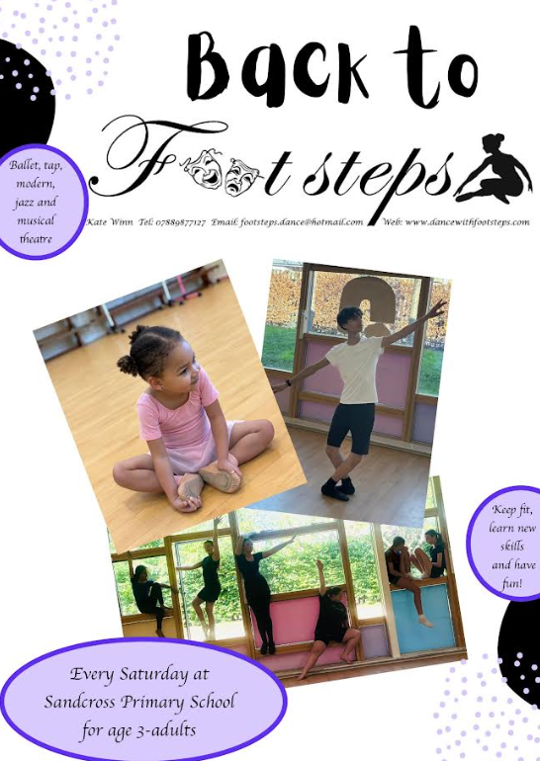
Year 5
Key Dates
Year 6
Key Dates

Slide 17

Year 5
Key Dates
Year 6
Key Dates

Slide 18
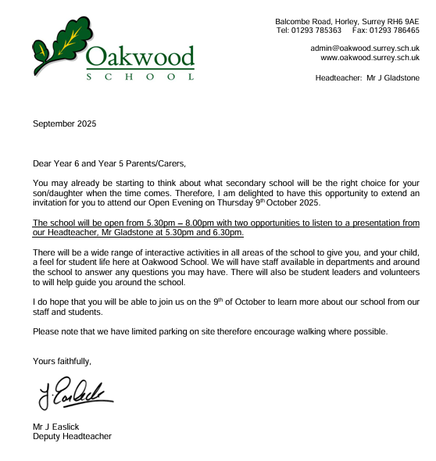
Year 5
Key Dates
Year 6
Key Dates

