Slide 1



Newsflash
26th September 2025
Important Communication Reminder
To ensure smooth and consistent communication with our teachers, we kindly ask all parents to email office@sandcross.school for any messages or queries.
Please do not include teachers’ personal email addresses in your messages. All communication will be directed through the school office.
Thank you for your support and cooperation.
We have a new Photography company for the upcoming school photos, click HERE for a letter with further details.
Parent feedback Questionnaire
Your feedback is important to us. Kindly share it by completing this form.
We kindly remind you that we are no longer able to accept sweets in school for children’s birthdays. Unfortunately, due to allergies, we cannot allow these to be handed out in class.
If you would like to share sweets to celebrate your child’s birthday, please do so on the playground. We also strongly advise that you hand them directly to other parents, rather than giving them to children.
We apologise for any inconvenience and thank you for your understanding and support in keeping all children safe.
Road Safety Information from Surrey CC
https://www.surreycc.gov.uk/roads-and-transport/road-safety/outside-schools
Club Pick-Up Locations
All after-school clubs dismiss from the main playground area.
For each club pick up location, please refer to the clubs timetable which will explain where abouts the club leader will stand and dismiss your child. Autumn Term clubs timetable
Wk/beginning 29th September PE Kit
Reception - Wednesday & Friday
Year 1 - Tuesday & Wednesday
Year 2 - Tuesday (no change due to Great Fire of London workshop)& Wednesday
Year 3 - Tuesday and Thursday ( Stone Age Workshop to be carried out in PE kit)
Year 4 - Tuesday & Thursday
Year 5 - Monday & Friday
Year 6 - Wednesday & Friday (swimming kit for Wednesday)

Slide 2
Wednesday 1st October - Uniform sale - 2:30pm-4:30pm via the Oasis gate (walk past the main gate towards South Park and it is a small gate further up)
Thursday 2nd October - Harvest Festival Lunch - Form to order a lunch - HERE
Monday 6th October - Y3 Open Morning - Further details to follow
Wednesday 8th October - SEND Coffee Morning - 08:45-10:15am - Form to sign up
Thursday 9th October - EYFS Open Morning - Further details to follow
Monday 13th October - Parents Evening - Letter
Thursday 16th October - Parents Evening
Friday 17th October - Individual Photos - Letter
Tuesday 21st October - Mufti Day
Wednesday 22nd - Friday 24th October - Inset Days
Monday 27th October - Friday 31st October - Half Term
Monday 3rd November - Inset Day
Wednesday 5th & Monday 10th November - Flu Vaccinations - Letter
Monday 10th November - Y3 Open Evening - Further details to follow
Friday 14th November - 14:30 - Parent Phonics information presentation - open for Nursery, Reception, Year 1, year 2, year 3 parents in studio
Wednesday 19th November - EYFS Open Evening - Further details to follow
Monday 1st December - Year 3 Open Evening - Further details to follow
Friday 5th December - Friends of Sandcross in school Christmas Event - details to follow
Thursday 18th December - Mufti Day & Christmas dinner
Friday 6th February - Mufti day - colours that make you happy to support Children's Mental Health Week
Friday 27th February - Uniform donation collection on the main playground at drop off and pick up
Wednesday 4th March- Uniform sale - 2:30pm-4:30pm via the Oasis gate (walk past the main gate towards South Park and it is a small gate further up)
Friday 27th March - Friends of Sandcross Easter Fun Day - details to follow
Friday 8th May - Uniform donation collection on the main playground at drop off and pick up
Wednesday 13th May- Uniform sale - 2:30pm-4:30pm via the Oasis gate (walk past the main gate towards South Park and it is a small gate further up)
Friday 22nd May - Mufti day
Friday 5th June - Friends of Sandcross Family Festival 4:30-9pm - details to follow
Monday 6th July - Sports Day - Nursery, Reception (am) Year 1 and Year 2 (pm)
Friday 10th July - Sports Day - Year 3, 4 (am) 5 and 6 (pm)
Tuesday 21st July - Last day of term & mufti day
Whole School Dates
Click HERE to see the term dates for 2025-2026
All dates in red are new additions
All dates in blue have already been sent out

Slide 3
Nursery
Trips/Events 25/26 Summary - Letter
Thursday 9th October- Early Years Teddy Bears Picnic - Letter
Friday 14th November - 14:30 - Parent Phonics information presentation - open for Nursery, Reception, Year 1, year 2, year 3 parents in studio
Tuesday 9th December - Nursery Christmas Performance - Time to follow
In Nursery this week…..
This week we have been learning all about our facial features and have been drawing and painting 'self portraits' using mirrors to identify our unique features.
In our group time we have been enjoying facial features activities and talking about the senses each feature links to.
Our first story of the week has been 'Owl Babies', the children have loved revisiting the story each day and naming the baby owls along with joining in with key repeated text.
They have explored our Owl Babies interest tray filled with feathers, pine cones, twigs and picture prompts from the story along with pre recorded sound buttons with words linked to the story for them to repeat.
Our number of the week has been 2 and our colour of the week has been yellow. When discussing things that are yellow some of the children mentioned 'lemons' and melons', so Mrs Bryant went off to the shops to buy both so that we could have a 'yellow fruit' food tasting experience. Most of the children loved the 'sweet' melon, and a couple of them even enjoyed the 'sour' lemon! Next week our colour will be green, can you discuss 'things that are green' with your child over the weekend?
On Thursday as part of our phonics learning we went off on a listening walk around the school environment. The children loved exploring the school field while listening to different types of birds, leaves rustling in the wind and even a chainsaw chopping trees in the distance! They were so well behaved as we walked through the main school building listening to people chatting, children playing and dishes rattling in the school kitchen.
As you have hopefully all seen in my written message we would love each child to bring a shoebox or any type of box with a lid into the nursery by next Friday (named please). These will be made into 'Family boxes' and sent back home for you to fill before returning them to us to share with the whole class.
If you are unable to locate a box let us know and I'm sure we can source one for you.
If anyone is having difficulty booking a parents evening slot please come and talk to me. I have the same time allocation as all of the other classes in the main school but 10 more children!
I will happily book appointments either before or after school either in the week leading up or when we return after half term.
Thank you so much for your understanding,
Have a wonderful weekend,

Slide 4
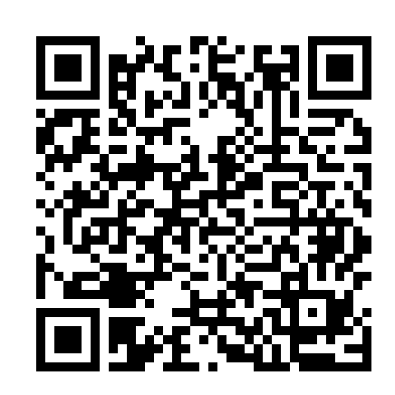
Reception
Trips/Events 25/26 Summary - Letter
Tuesday 30th September - Reception Road Safety Day - Letter
Tuesday 7th October - Reception disco 4:30pm - 5:30pm - Parents to stay please - Tickets can be purchased HERE
Thursday 9th October- Early Years Teddy Bears Picnic - Letter
Friday 14th November - 14:30 - Parent Phonics information presentation - open for Nursery, Reception, Year 1, year 2, year 3 parents in studio
Wednesday 10th & Thursday 11th December - Reception, Year 1 and Year 2 Xmas Performance - Each mixed year group will perform twice – once in the morning and once in the afternoon – to ensure every child has the opportunity to perform at both times of day. Further details to follow
Wednesday 15th July - 10am Reception Class assembly - Zoom Link
In Reception this week…
What another fantastic week the children have had. This week the children have been learning the story 'Brown Bear, Brown Bear, what do you see?'. We then learnt about different colours and how you can mix two colours together to make a new colour. Also, the children then looked at themselves in a mirror and created amazing self-portraits.
We have also started Phonics, learning the sounds m,a,s,d,t. Today, your child will come home with their homework folder and a sticker with the sounds they have learnt. Please ask your child to say the sounds to you. In their homework folder you will find some practice sheets for your child to consolidate the formation of each letter. Please bring your child's homework folder back into school every Wednesday.
Please see below the QR code & link which will take you directly to the Read Write Inc site with some videos that your child can watch to ensure they are saying the correct pronunciation of sound.
http://schools.ruthmiskin.com/resources/vc-pathways/251737/VSWBk4FpEdvciAYt
Thank you for your c continued support, we hope you have a wonderful
weekend.
The Reception Team

Slide 5
Year One
Trips/Events 25/26 Summary - Letter
Monday 6th October - Year 1 & 2 disco 4:30 - 5:30pm - Tickets can be purchased HERE- First come first serve
Tuesday 14th October - Y1 Trip to Gatton Park - Letter
Friday 14th November - 14:30 - Parent Phonics information presentation - open for Nursery, Reception, Year 1, year 2, year 3 parents in studio
Thursday 20th November - Y1 and Y2 Inspire Session - (parent can visit their child’s class and observe the learning)
Wednesday 10th & Thursday 11th December - Reception, Year 1 and Year 2 Xmas Performance - Each mixed year group will perform twice – once in the morning and once in the afternoon – to ensure every child has the opportunity to perform at both times of day. Further details to follow
Wednesday 20th May - 10am 1 Bodiam Class assembly - Zoom Link
Wednesday 8th July - 10am 1 Hever Class assembly - Zoom Link
Home learning letter - Letter
In Year 1 this week……
We have been amazing learners and have made our adults at school very proud!
Maths: In maths this week we have been thinking about greater than, less than and equals to. We have been using mathematical symbols in our work to show this!
English: In English we started a story called The Mixed Up Chammeleon. We have spent this week understanding the story and looking at mixed up animals!
Art: This week we started our art topic and have been learning about a famous artist called George Seurat. We have been practicing his technique of pointalism and have focused on drawing animals which we learnt about in science.
At home: Please continue to read at home as much as possible. We will be sending home learning in the book bags. Please can this be returned on Wednesday next week so that we can have a look at the children’s work.
Reminders: The field is open at lunchtime, please ensure your child has a named pair of wellies in school to enable them to enjoy this. We would also like to remind you that we are a nut-free school and snacks should be healthy. Please ensure that your child has a coat in school so we are able to go outside during showers.
We had our first visit to the library this week! Our day to visit the library is a Monday so please ensure your child has their library book with them on a Monday.
If you are able to help with the Gatton trip on Tuesday 14th October please let your class teacher know. We will be travelling by minibus but will need our parent volunteers to make their own way to and from the venue. We also have the sign up sheets ready for Mystery Reader so please see your class teacher if you would like to sign up for a slot.

Slide 6
Year Two
Trips/Events 25/26 Summary - Letter
Monday 6th October - Year 1 & 2 disco 4:30 - 5:30pm - Tickets can be purchased HERE - First come first serve
Friday 14th November - 14:30 - Parent Phonics information presentation - open for Nursery, Reception, Year 1, year 2, year 3 parents in studio
Thursday 20th November - Y1 and Y2 Inspire Session - (parent can visit their child’s class and observe the learning)
Wednesday 10th & Thursday 11th December - Reception, Year 1 and Year 2 Xmas Performance - Each mixed year group will perform twice – once in the morning and once in the afternoon – to ensure every child has the opportunity to perform at both times of day. Further details to follow
Wednesday 6th May - 10am 2 Paddington Class Assembly - Zoom Link
Wednesday 17th June - 2 Waterloo Class assembly - Zoom Link
Home learning letter - Letter
Year Two
Maths: We have been learning how to compare and order numbers and groups of objects. We used place value to look at the tens and ones to decide which number is greater than, less than, or equal to, and showed this using the symbols <, >, =. We practised using the words least, most, fewest, and greatest to put numbers in the correct order, and used number lines to help. We also worked on counting in 2s, 5s and 10s to find and describe number patterns. In addition, we practised counting forwards and backwards in 3s using objects, number lines and hundred squares, spotting patterns and checking for mistakes in sequences.
English: This week in English we used everything we’ve learned over the past few weeks to write our own diary entries about the Great Fire of London. Reading them back has made it feel like we were really there! We have continued working on our recounts, carefully editing and improving them before publishing our final drafts ready for our class display.
Topic: We enjoyed a Great Fire of London workshop, acting out scenes and showing fantastic knowledge and enthusiasm. In our topic work, we explored the role of firefighters and how they have changed from the past to today. We also had our first computing lesson, learning how to refine searches, share work on display boards, and use Purple Mash to communicate and understand sharing safely online.
At home: Please continue practising reading at home as often as possible. We have begun our home reading incentive which the children may have told you about. For every read at home (recorded in their planner) they will receive a raffle ticket. This will get drawn from every two weeks - so the more home reading the more raffle tickets!
Home learning this week is paper-based. A gentle reminder that home learning is due on Wednesday.
Reminders: Soon we will be making our Great Fire of London House so we would welcome cereal boxes please in order for every child to be able to make their own house. We are also still looking for donations of any spare underwear / socks or uniform that we can use as spares in school in case of accidents.
Thank you for your continued support and cooperation.

Slide 7
Year Three
Trips/Events 25/26 Summary - Letter
Tuesday 30th September - Stone age Day - Letter
Wednesday 8th October - 10am 3 Buckland Class assembly - Zoom Link
Thursday 9th October - Y3 Disco - 4:30-5:30pm - Tickets can be purchased HERE
Friday 14th November - 14:30 - Parent Phonics information presentation - open for Nursery, Reception, Year 1, year 2, year 3 parents in studio
Wednesday 26th November - 10am 3 Wray Class assembly - Zoom Link
Tuesday 16th December - Year 3 and 4 at Reigate Baptist Church (1:30 pm)
Wednesday 4th March to Wednesday 20th - Swimming - Letter
Year 3 have been getting ready for their first themed day of the year this week. They have been learning about Stone Age tools and the way of life. I am looking forward to joining them for part of their Stone Age Day next Tuesday.
I have been in the classes again this week, in both maths and English lessons and the standard of work, both presentation and content has really impressed me, as well as their independence. They are in the routine of coming in first thing, or after break and setting up their books ready for the learning - very impressive after just 4 weeks.
Mr Crossland’s class is busily rehearsing their assembly, which is in two weeks - they were quite excited to tell me what they are doing and I will see you there on October 8th.

Slide 8
Year Four
Trips/Events 25/26 Summary - Letter
Thursday 9th October - Y4 Disco 6-7pm - Tickets can be purchased HERE
Wednesday 5th November - Year 4 Swimming starts
Thursday 13th November - Y4 9:15am Inspire Session - (parent can visit their child’s class and observe the learning)
Wednesday 19th November - 10am 4 Mersey Class assembly - Zoom Link
Tuesday 16th December - Year 3 and 4 at Reigate Baptist Church (1:30 pm)
Wednesday 21st January - 10am 4 Bann Class assembly - Zoom Link
Wednesday 28th January - 10am 3 Orchards Class assembly - Zoom Link
Wednesday 18th March - 10am 4 Tay Class assembly - Zoom Link
Wednesday 5th November to Wednesday 10th December and Wednesday 7th January to Wednesday 4th February - Swimming - Letter
Year 4 have had another busy week, continuing their work on the Romans and on teeth!
I was super proud of 4 Wye on Wednesday for putting on the first class assembly of the year, based on our new topic. They were confident, and their enjoyment and enthusiasm was clear to see. They performed it three times in the studio to enable all of Year 3 and 4 to watch as well as many parents.
I hope you have enjoyed listening to your child playing their trumpet at home! At least it is quieter for you than hearing 30 at once! Again, their enthusiasm is infectious and the trumpet teacher has commented time and time again how keen they are.
Thank you attending the meeting about Bowles this week Please ensure you have signed your child up for the trip - at last glance, we had over 70 replies. As we said on the night, it is so important to sign up to ensure your child has a place booked.
Bowles Information Evening Recording Link Passcode: gHp8&tnH

Slide 9
Year Five
Trips/Events 25/26 Summary - Letter
Wednesday 1st October - 5 Peake Class assembly 10am - Zoom Link
Monday 6th October - 6-7pm Year 5 & 6 Disco - Tickets can be purchased HERE
Thursday 9th October - Y5 Inspire Session 9:15am - (parent can visit their child’s class and observe the learning)
Wednesday 12th November - 10am 5 Armstrong Class assembly - Zoom Link
Monday 15th December - Year 5 and 6 at Reigate Baptist Church Xmas Performance (1:30 pm) Details to follow
Wednesday 11th March - 10am 5 Jemison Class Assembly - Zoom Link
Wednesday 3rd June to Wednesday 1st July - Swimming - Letter
Year 5 Weekly Update:
This week, in year 5 we have used everything learnt so far about the Victorians, to write formal letters. The children have taken on the role of 'Jim Jarvis', a character from 'Streetchild' by Berlie Doherty and have put themselves in his position when writing letters, asking for help.
In maths, our flexible groups have continued and we are in the final few weeks of place value learning, before moving onto addition and subtraction soon.
Art lessons have focused on the famous Victorian artist, William Morris. We have been so impressed with the care that the children have taken when recreating a section of one of his famous patterns. They have included such detail, this has taken real resilience!
Home learning this week will be a paper copy of an English task. Please encourage your child to complete this. The class teacher will go through this task next Friday in class.
5 Peake Parents
The children are looking forward to their class assembly on Wednesday 1st October.
Please can the children bring in their Victorian costumes which they wore on Victorian day, on Monday 29th September in a named bag. These will be returned after the assembly.

Slide 10
Year Six
Trips/Events 25/26 Summary - Letter
W/B 29nd September - Year 6 tutoring starts (invited children only - letter to follow)
Thursday 2nd October - Y6 Inspire Session 9:15am- (parent can visit their child’s class and observe the learning)
Monday 6th October - 6-7pm Year 5 & 6 Disco - Tickets can be purchased HERE
Wednesday 15th October - 10am 6 Marley Class Assembly - Zoom Link
Monday 15th December - Year 5 and 6 at Reigate Baptist Church (1:30 pm) Xmas Performance - Details to follow
Wednesday 14th January - 10am 6 Beatles Class Assembly - Zoom Link
Wednesday 11th February - 10am 6 Franklin Class Assembly - Zoom Link
Wednesday 4th March - 10am 6 Presley Class Assembly - Zoom Link
June 2026 - IOW Residential - Letter
Year 6 Weekly Update:
Year 6 have been busy this week planning their stories about evacuee children going on a journey to escape the Blitz. They are using their learning from our recent trip to Newhaven Fort to assist with this as they put themselves in the position of one of these children. In maths, we are continuing with our work on the 4 operations and have moved on to factors, multiples and prime numbers. In our history lessons, we have been comparing the opinions of Neville Chamberlain and Winston Churchill as the country prepared for war in 1939.
In geography, we have confirmed with our work about Europe and in Science, we have been learning about which light sources can pass through materials. In our Art lessons, we have been completing our portraits, with images of what we like to do in our spare time inside half of the face.
Well. done to all for another great week with your swimming lessons. The teachers at Hawthorns were very impressed and you demons tested our school values beautifully.
Home learning this week will be a paper copy of a maths and English task. Please encourage your child to complete this. The class teacher will go through this task next Friday in class.

Slide 11
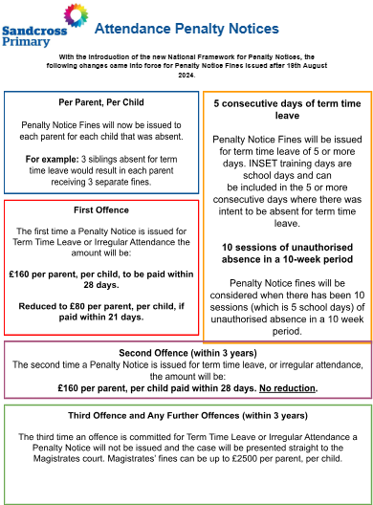
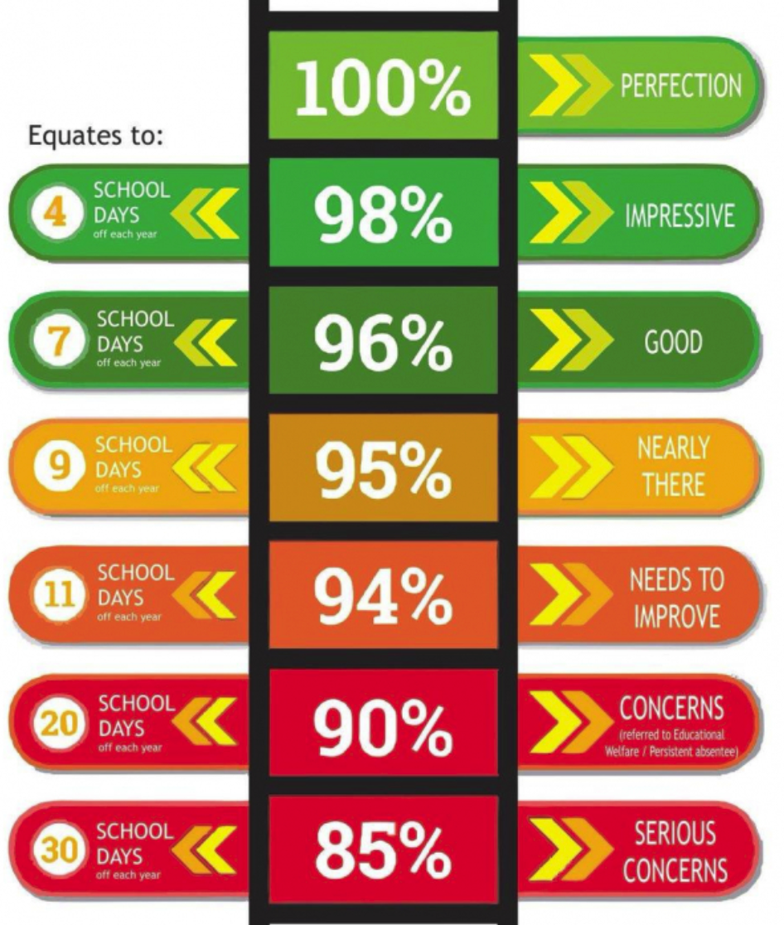
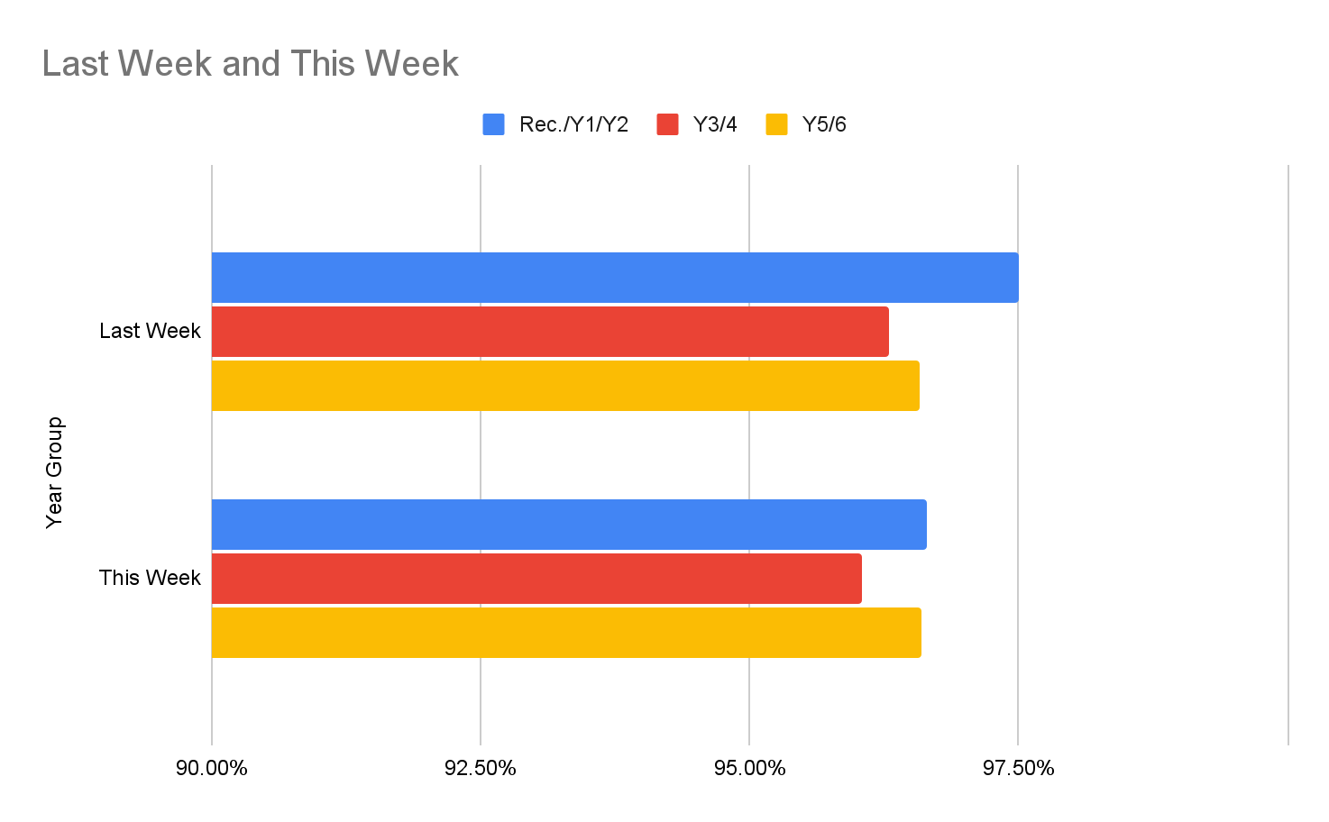

Newsflash
12th September 2025
← Extra Break Winners

Slide 12


Autumn Disco
Friends of Sandcross are really happy to announce that we will be hosting Autumn Discos for all children in
Reception to Year 6
The dates and times are as follows:
Year 1 & 2 Monday 6th October 4.30pm-5.30pm
Year 5 & 6 Monday 6th October 6pm-7pm
Reception Tuesday 7th October 4.30pm-5.30pm
Year 3 Thursday 9th October 4.30pm-5.30pm
Year 4 Thursday 9th October 6pm-7pm
Entry cost is £3.50 per child and will include a drink and packet of Pom-Bear crisps. We ask that reception parents must stay with their children at the disco (no siblings please).
Any SEND children that would benefit from having a parent with them, we ask from them to stay.
If you would like your child to attend, please complete the form below and make payment via the link below.
https://booking.bookinghound.cloud/fe/booking?og=b0e0a52a-3433-41e8-b3aa-54236123d515
We would love for all children to be able to attend the discos if they would like to. If you are a low income family and require financial support in purchasing a ticket please contact the school office by email at office@sandcross.school.
Thank you
FOS Committee
Year 5
Key Dates
Year 6
Key Dates

Slide 13
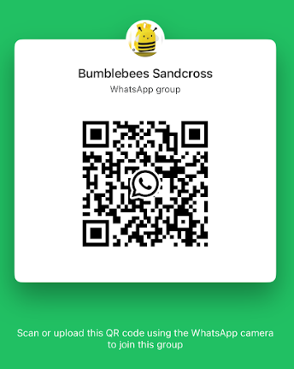
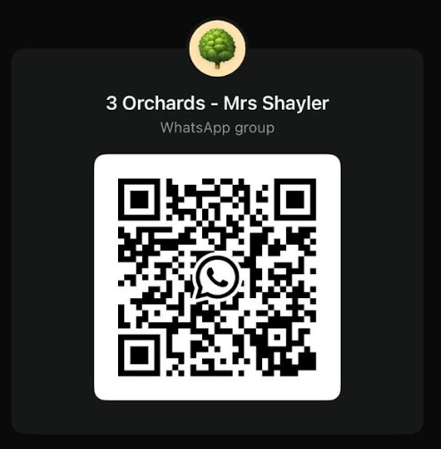
Whatsapp QR Codes
If you would like your class whatsapp code on here, please speak to your class reps
*Please note that class Whatsapp are NOT an official school communication. These are informal ONLY*

Slide 14
Parent Rep’s for your child’s class
Ladybirds | Isabelle Piris
Bumblebees | Victoria Ferrier | Kate Cooper | Mary A
Dragonflies | Sara Mackelworth-Ives
1 Bodiam | Ellis Reilly
1 Hever | Abiodun O
2 Waterloo | Charlotte Bull
2 Paddington | Charlotte Bull | Amelia Packham
3 Wray | Emese Gaal
3 Buckland | Ellis Reilly
3 Orchards | Victoria Ferrier | Amelia Packham
4 Tay | Kirsty Howell | Joy Cook
4 Bann | Charlotte Vallis
4 Wye | Hayley Holmes
4 Mersey
5 Goble | Jennifer Kirby
5 Jemison | Amanda Fletcher
5 Peake | Sally David | Jana Redelinghuys
5 Armstrong | Annette James | Sonja Bowden
6 Marley | Lydia Poerstamper
6 Presley | Suzi Lawrence
6 Beatles
6 Franklin | Gemma Bowden
Year 5
Key Dates
Year 6
Key Dates

Slide 15

Harvest Festival Lunch
Thursday 2nd October 2025
Please complete this form to order a lunch Harvest Festival School Lunch Form
Year 5
Key Dates
Year 6
Key Dates

Slide 16

Year 5
Key Dates
Year 6
Key Dates

Slide 17

Year 5
Key Dates
Year 6
Key Dates

Slide 18

23 September 2025
Dear Parents,
Reigate Grammar School Invitation to Virtual Live Q&A: Tuesday 7 October 2025
We are delighted to invite you to a Virtual Live Q&A with Mr. Shaun Fenton, Headmaster of Reigate Grammar School, on Tuesday 7 October 2025 from 6:00-7:00pm. This will be a fantastic
opportunity for you to learn more about RGS, our values, and how we create a nurturing environment where students excel both academically and personally. You will also have the
chance to ask any questions you may have about the school and the opportunities it offers.
Event Details:
• Date: Tuesday 7 October 2025
• Time: 6:00pm - 7:00pm
• Format: Virtual Live Q&A via MS Teams, via this link.
Please click here to register for the event. We look forward to welcoming you online and sharing more about how RGS might be the right fit for your child’s educational journey.
Warm regards
Jane Callaghan
Admissions Team
Year 5
Key Dates
Year 6
Key Dates

Slide 19

Year 5
Key Dates
Year 6
Key Dates

Slide 20

Year 5
Key Dates
Year 6
Key Dates

