Slide 1


Newsflash
19th September 2025
Please click here to read a letter from Mr Richards reflecting on the first two weeks of school.
Please click HERE to see a letter with important information about our caterer Twelve15.
Click HERE for a letter about the upcoming Parents Evening.
Mufti Days
We have seven mufti days planned throughout the school year! On these days, children can come to school in their own clothes, and we ask for a £1 donation to support our Friends of Sandcross fundraising efforts.
Some of these mufti days may be themed (for example, dressing in a certain colour or style), and we’ll always let you know in advance so your child can join in the fun.
To make life a little easier, you now have the option to make one single payment of £7 through the Arbor School Shop. This covers all seven mufti days – so no need to remember to send in £1 each time! Of course, if you prefer, you can still bring £1 on each mufti day as usual.
Thank you so much for supporting our school – every pound helps us fund exciting projects and activities for the children.
If your child is riding to school on a bike or scooter, please can we kindly remind you to ensure that they are safe by wearing a helmet and, where possible, other protective gear such as knee and elbow pads.Your child’s safety is our top priority, and taking these simple precautions helps keep everyone safe on the journey to and from school.We would also like to remind all drivers to be extra cautious, avoid speeding, and drive responsibly near the school area to ensure the safety of all children and pedestrians.
Wk/beginning 22nd September PE Kit
Reception - Wednesday & Friday
Year 1 - Tuesday & Wednesday
Year 2 - Tuesday (no change due to Great Fire of London workshop)& Wednesday
Year 3 - Tuesday & Thursday
Year 4 - Tuesday & Thursday
Year 5 - Monday & Friday
Year 6 - Wednesday & Friday (swimming kit for Wednesday)

Slide 2


Reminders/ Upcoming events
Christmas Cards
Christmas is fast approaching and it’s time for our annual Christmas Card Fundraising Project!
Please click HERE for further information
Donations!
We are desperately seeking donations of any material, buttons,coloured threads, cotton etc. for our new sewing club!!
Also if you have a sewing machine at home you no longer need, please consider donating it to the school so the children can use it in the sewing club!
Please contact the school office to arrange a suitable time to drop off your items.
Thank you for your help!
Clubs start on Monday 22nd September!
Please familiarise yourself with your pick up locations for the after school clubs which are listed on the clubs timetable.
Children are reminded to wear suitable clothing and footwear for their club and suitable for the weather.
Outdoor Project / Gardening - Children should bring wellies or an old pair of outdoor shoes and old warm clothing, suitable for the weather.
Art clubs - children should bring an old shirt or t-shirt to wear over their uniform to protect the uniform.
Martial arts clubs - children should wear comfortable clothing, preferably with their legs covered (jogging bottoms/leggings).
Please could any harvest donations be dropped into school on Thursday 25th September.
We will have buckets available on the playground at both drop-off and pick-up times. Children are also welcome to bring their donations into school and drop them off once they are inside.
Thank you very much for your support with this.

Slide 3
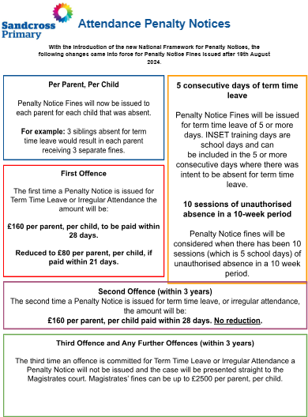
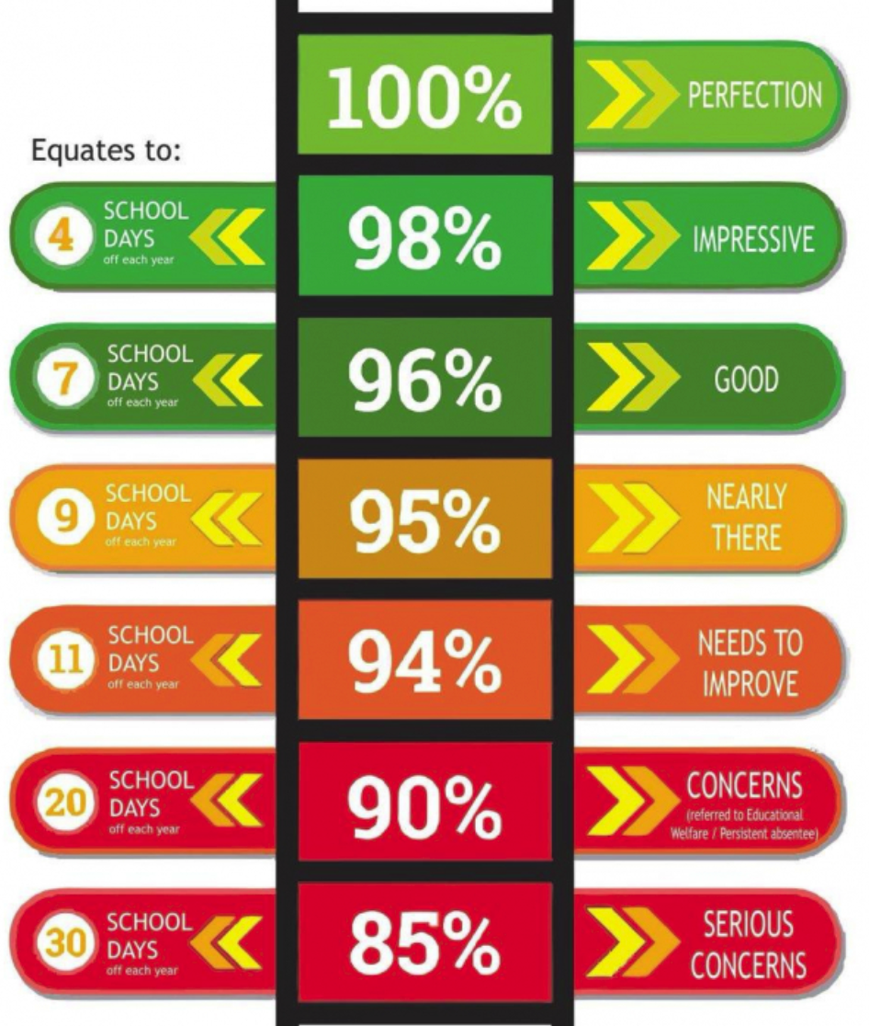
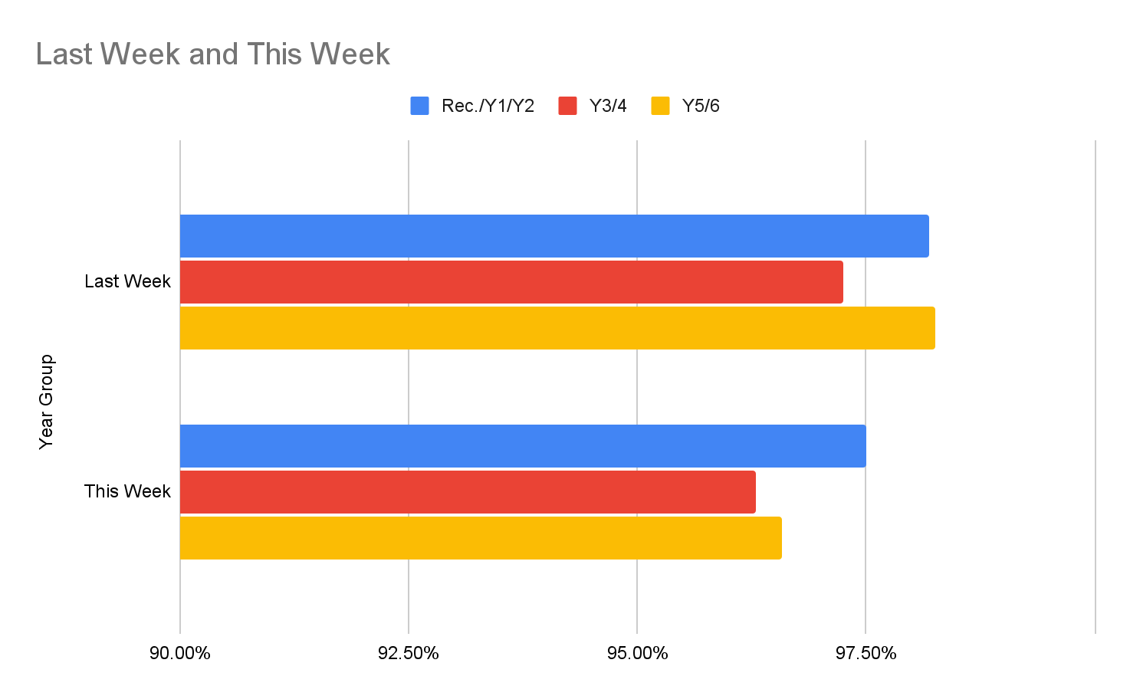

Newsflash
12th September 2025
Please click HERE to see a letter regarding attendance
← Extra Break Winners

Slide 4
Monday 22nd September - Clubs start - Letter
Friday 26th September - Uniform donation collection on the main playground at drop off and pick up
Wednesday 1st October - Uniform sale - 2:30pm-4:30pm via the Oasis gate (walk past the main gate towards South Park and it is a small gate further up)
Thursday 2nd October - Harvest Festival Lunch - Form to order a lunch - HERE
Monday 6th October - Y3 Open Morning - Further details to follow
Thursday 9th October - EYFS Open Morning - Further details to follow
Monday 13th October - Parents Evening - Letter
Thursday 16th October - Parents Evening
Friday 17th October - Individual Photos - details to follow
Tuesday 21st October - Mufti Day
Wednesday 22nd - Friday 24th October - Inset Days
Monday 27th October - Friday 31st October - Half Term
Monday 3rd November - Inset Day
Wednesday 5th & Monday 10th November - Flu Vaccinations - Letter
Monday 10th November - Y3 Open Evening - Further details to follow
Wednesday 19th November - EYFS Open Evening - Further details to follow
Monday 1st December - Year 3 Open Evening - Further details to follow
Friday 5th December - Friends of Sandcross in school Christmas Event - details to follow
Thursday 18th December - Mufti Day & Christmas dinner
Friday 6th February - Mufti day - colours that make you happy to support Children's Mental Health Week
Friday 27th February - Uniform donation collection on the main playground at drop off and pick up
Wednesday 4th March- Uniform sale - 2:30pm-4:30pm via the Oasis gate (walk past the main gate towards South Park and it is a small gate further up)
Friday 27th March - Friends of Sandcross Easter Fun Day - details to follow
Friday 8th May - Uniform donation collection on the main playground at drop off and pick up
Wednesday 13th May- Uniform sale - 2:30pm-4:30pm via the Oasis gate (walk past the main gate towards South Park and it is a small gate further up)
Friday 22nd May - Mufti day
Friday 5th June - Friends of Sandcross Family Festival 4:30-9pm - details to follow
Monday 6th July - Sports Day - Nursery, Reception (am) Year 1 and Year 2 (pm)
Friday 10th July - Sports Day - Year 3, 4 (am) 5 and 6 (pm)
Tuesday 21st July - Last day of term & mufti day
Whole School Dates
Click HERE to see the term dates for 2025-2026
All dates in red are new additions
All dates in blue have already been sent out

Slide 5
Nursery
Key Dates
Trips/Events 25/26 Summary - Letter
Thursday 9th October- Early Years Teddy Bears Picnic - Letter
Tuesday 9th December - Nursery Christmas Performance - Time to follow
Half Termly Newsletter
In Nursery this week…..
The children have settled so well into Ladybirds life it's quite unbelievable that it's only our second full week. They are doing so well with following classroom routines and now have their own carpet spaces for carpet time sessions which they are mostly finding independently.
This week we have been talking about our school value of 'Responsibility' with the help of our class value pet 'Ruby' the Rabbit. With Ruby's help the children are beginning to understand that they have their own responsibilities in the classroom such as hanging up their coat when they come in from outside and putting their wellies back on the wellie rack. All around the classroom we have been hearing adult voices reminding those who have dropped their coats on the floor of their responsibility along with some of the children reminding others of this too!
We have been using 'group time' to get to know the children a little better and to complete some simple number assessments and communication activities.
We have also introduced our Number of the week :1, and our colour of the week: red. Ask your child about them both and hopefully this will lead to interesting discussions at home.
Our nursery rhyme of the week has been 'Humpty Dumpty' and the children have enjoyed singing along as well as using collage materials to create their own Humpty.
By now some of you will have received a Tapestry observation for your child, we aim to complete at least one for every child by the end of next week.
Next week we will begin to introduce our 'Story of the week' which we will read daily to support understanding, encourage the children to join in with repeated phrases in the text and make predictions of what might happen next.
I hope you all feel that your child has settled well into Ladybird life,however if you have any concerns that you would like to discuss please do speak to me at drop off or pick up time.
Gentle reminder: Please do not send your child into nursery with an unhealthy snack, cakes and biscuits are classed as this and should be kept for after school or as a treat in their lunchbox. Thank you so much for helping to support healthy eating in Ladybirds.
Have a wonderful weekend,
Kind regards,
Mrs Darar and the Nursery team.

Slide 6
Reception
Key Dates
Trips/Events 25/26 Summary - Letter
Tuesday 30th September - Reception Road Safety Day - Letter
Tuesday 7th October - Reception disco 4:30pm - 5:30pm - Parents to stay please - Tickets can be purchased HERE
Thursday 9th October- Early Years Teddy Bears Picnic - Letter
Wednesday 10th & Thursday 11th December - Reception, Year 1 and Year 2 Xmas Performance - Each mixed year group will perform twice – once in the morning and once in the afternoon – to ensure every child has the opportunity to perform at both times of day. Further details to follow
Wednesday 15th July - 10am Reception Class assembly - Zoom Link
Half Termly Newsletter
In Reception this week…
The children have had a fantastic week at school. They continue to blow us away with how well they are settling into life at Sandcross. They are showing great maturity and resilience when learning new routines and continue to make us proud. This week we have been learning about our families. We have talked about how all families come in different shapes and sizes but all have ‘love’ in common.
The children were asked to draw a picture of their own family and explain why they are special to them. This was a great way to find similarities and differences between ourselves and our new friends. To help support our learning, we are asking all parents to please provide a photograph of your family for us to make a classroom display. This helps children to spark conversations and find common ground with their new friends. If you are unable to print at home please email a copy to the school office and we will print it for you at school!
On Wednesday the children also had their first visit to the Library. This week we read a story and introduced the children to the way the library operates. The children will be regularly visiting the library during their time in Reception, typically on a Wednesday afternoon. As of next week, 24th September, the children will begin to take out some of our wonderful books to read with you at home. Please take a look at these books and enjoy them with your children.. We do ask that the children return these weekly, so please ensure that they are in the children's book bags when they come to school each Wednesday. I'm afraid if the book is not returned children will not be able to take further books out until it comes back to school.
As the weather is getting colder and we are having lots more rain, can we please ask you to help your child to practise putting on their coats independently. This includes turning sleeves the right way if they are inside out, putting their arms in both holes on their own and doing up the zip.
Lastly, a huge thank you to those parents who have swapped out the rucksacks for a bookbag. It really does help your child to be independent when putting their coats on their pegs. We are still asking if anymore parents would also kindly swap to a bookbag if possible. With 60 children sharing one space we are having lots of children unable to find their coats, put them on their pegs or even take them off their pegs! As the children begin to bring home library books and homework folders, a book bag will mean they can comfortably fit everything inside and fit perfectly into their trays.

Slide 7
Year One
Key Dates
Trips/Events 25/26 Summary - Letter
Monday 6th October - Year 1 & 2 disco 4:30 - 5:30pm - Tickets can be purchased HERE- First come first serve
Tuesday 14th October - Y1 Trip to gatton Park - Letter to follow
Thursday 20th November - Y1 and Y2 Inspire Session - (parent can visit their child’s class and observe the learning)
Wednesday 10th & Thursday 11th December - Reception, Year 1 and Year 2 Xmas Performance - Each mixed year group will perform twice – once in the morning and once in the afternoon – to ensure every child has the opportunity to perform at both times of day. Further details to follow
Wednesday 20th May - 10am 1 Bodiam Class assembly - Zoom Link
Wednesday 8th July - 10am 1 Hever Class assembly - Zoom Link
Home learning letter - Letter
Year 1 Curriculum Evening Recording Passcode: h?&JKK27
Half Termly Newsletter
In Year 1 this week……
We have been amazing learners and have made our adults at school very proud!
Maths: In maths this week we have been practising saying the number that is one more or one less than a given number. We have also been practising writing and reading numbers as words.
English: In English we practised writing sentences to describe our hobbies and favourite foods. Our finger spaces are really impressive and we are beginning to notice when we need to put a full stop.
Science: In science we looked at amphibians and reptiles and we investigated the life cycle of a frog.
At home: Please continue to read at home as much as possible. We will be sending home learning in the book bags. Please can this be returned on Wednesday next week so that we can have a look at the children’s work.
Reminders: The field will be open at lunchtime next week, please ensure your child has a named pair of wellies in school to enable them to enjoy this. We would also like to remind you that we are a nut-free school and snacks should be healthy. Please ensure that your child has a coat in school so we are able to go outside during showers.
If you are able to help with the Gatton trip on Tuesday 14th October please let your class teacher know. We will be travelling by minibus but will need our parent volunteers to make their own way to and from the venue. We also have the sign up sheets ready for Mystery Reader so please see your class teacher if you would like to sign up for a slot.
Many thanks Year 1 Team

Slide 8
Year Two
Key Dates
Trips/Events 25/26 Summary - Letter
Tuesday 23rd September - Y2 Great Fire of London Workshop in school - Letter
Monday 6th October - Year 1 & 2 disco 4:30 - 5:30pm - Tickets can be purchased HERE - First come first serve
Thursday 20th November - Y1 and Y2 Inspire Session - (parent can visit their child’s class and observe the learning)
Wednesday 10th & Thursday 11th December - Reception, Year 1 and Year 2 Xmas Performance - Each mixed year group will perform twice – once in the morning and once in the afternoon – to ensure every child has the opportunity to perform at both times of day. Further details to follow
Wednesday 6th May - 10am 2 Paddington Class Assembly - Zoom Link
Wednesday 17th June - 2 Waterloo Class assembly - Zoom Link
Home learning letter - Letter
Year 2 Curriculum Evening Recording Passcode: 1Y@kst#F
Half Termly Newsletter
Year Two
We have had another fun and busy week in Year 2!
Maths: This week, we have been working on how we can use counting patterns and number lines to help us find and understand numbers. We needed to spot whether the number lines were counting up in 1’s or 10’s or maybe even 2’s. Were they trying to trick us?
English: In English, we have been using everything we have learnt over the past couple of weeks to plan and write our own diary entry about The Great Fire of London. It has been great starting to read these back, it has felt like we were really there!
Science: In Science, we have continued our exploration of materials and their properties. We looked at whether certain materials could be bent, stretched or squashed.
At home: Please continue practising reading at home as often as possible.- we have begun our home reading incentive which the children may have told you about. For every read at home (recorded in their planner) they will receive a raffle ticket. This will get drawn from every two weeks - so the more home reading the more raffle tickets!
Home learning has been set on Century for the first time this week - we would welcome your feedback on how this works for you. We try to get a balance in order to keep the children motivated. You will find the logins for Century at the back of the children's planners.
Reminders: Soon we'll be making our Great Fire of London House so we would welcome cereal boxes please in order for every child to be able to make their own house. We are also still looking for donations of any spare underwear / socks or uniform that we can use as spares in school in case of accidents.
Thank you for your continued support and cooperation - Year 2 Team

Slide 9
Year Three
Key Dates
Friday 26th September - Y3 Inspire Session 9:15am & Coffee morning in the studio- (parent can visit their child’s class and observe the learning) - Letter
Trips/Events 25/26 Summary - Letter
Tuesday 30th September - Stone age Day - Letter to follow
Wednesday 8th October - 10am 3 Buckland Class assembly - Zoom Link
Thursday 9th October - Y3 Disco - 4:30-5:30pm - Tickets can be purchased HERE
Wednesday 26th November - 10am 3 Wray Class assembly - Zoom Link
Tuesday 16th December - Year 3 and 4 at Reigate Baptist Church (1:30 pm)
Wednesday 4th March to Wednesday 20th - Swimming - Letter
Half Termly Newsletter
Year 3 have continued to settle in well to their new school/key stage. They have been working hard on their topic of the Stone Age and I know they are excited about the upcoming Stone Age Day.
With the introduction of a larger soft start, the children are coming in happy and engaged and there are less tears at the gate! This is great to see.
Certainly when I go into the classrooms throughout the day, they are all happy, engaged and learning.
I look forward to seeing as many of you as possible in the Year 3 classrooms next Friday for their INSPIRE session and then afterwards in the studio for a cup of coffee. It will be a super opportunity for you to see for yourselves how settled they are.

Slide 10
Year Four
Key Dates
Trips/Events 25/26 Summary - Letter
Monday 22nd September - Bowles residential information presentation 5:00 via zoom LETTER
Wednesday 24th September - 4 Wye Class Assembly - Zoom Link
Thursday 9th October - Y4 Disco 6-7pm - Tickets can be purchased HERE
Wednesday 5th November - Year 4 Swimming starts
Thursday 13th November - Y4 9:15am Inspire Session - (parent can visit their child’s class and observe the learning)
Wednesday 19th November - 10am 4 Mersey Class assembly - Zoom Link
Tuesday 16th December - Year 3 and 4 at Reigate Baptist Church (1:30 pm)
Wednesday 21st January - 10am 4 Bann Class assembly - Zoom Link
Wednesday 28th January - 10am 3 Orchards Class assembly - Zoom Link
Wednesday 18th March - 10am 4 Tay Class assembly - Zoom Link
Wednesday 5th November to Wednesday 10th December and Wednesday 7th January to Wednesday 4th February - Swimming - Letter
Year 4 Curriculum Evening Recording Passcode: v33Rdu%1
Half Termly Newsletter
What a busy week for Year 4!
Two classes started their trumpet lessons this week - if your child is in Mersey or Wye, please ensure you have filled in the permission form so that next week your child can bring home their trumpet to rehearse and show you what they have been learning!
Tuesday and Wednesday saw all of Year 4 take part in Roman Day. They had a wonderful time in the studio with History Off The Page. Fiona, the leader, was so impressed with their listening skills, their perseverance with some quite tricky tasks in the morning and with their enthusiasm all day. I saw acting, dancing, marching as well as lots of eating going on in the afternoon. We will make a display of photos in the Y4 block so that you can see for yourselves what they got up to.
Thank you for providing the costumes - they looked incredible too.
Bowles 2026
I spent this morning at Bowles, seeing the accommodation and the activities for myself - the children are going to have a brilliant time next February. Please remember there is a meeting online on Monday at 5pm where you will find out everything you need to know about the trip.

Slide 11
Year Five
Key Dates
Trips/Events 25/26 Summary - Letter
Wednesday 1st October - 5 Peake Class assembly 10am - Zoom Link
Monday 6th October - 6-7pm Year 5 & 6 Disco - Tickets can be purchased HERE
Thursday 9th October - Y5 Inspire Session 9:15am - (parent can visit their child’s class and observe the learning)
Wednesday 12th November - 10am 5 Armstrong Class assembly - Zoom Link
Monday 15th December - Year 5 and 6 at Reigate Baptist Church Xmas Performance (1:30 pm) Details to follow
Wednesday 11th March - 10am 5 Jemison Class Assembly - Zoom Link
Wednesday 3rd June to Wednesday 1st July - Swimming - Letter
Year 5 & 6 Curriculum Evening Recording Passcode: 1FbdG&ta
Half Termly Newsletter
Year 5 Weekly Update:
Year 5 have had a very busy week this week. We have started maths lessons in flexible groups and the adults have been so impressed with the mature way that the children have approached this. They have understood the truly flexible nature of these groups and we have seen some movement between groups already.
On Thursday, the year 5 corridor was transported back to the Victorian era, during our Victorian Day. Children could be heard chanting times tables facts and singing the National Anthem. Over the course of the day, they experienced what life would have been like as a Victorian school child; with lessons focused around the '3 Rs'. In the afternoon, they were able to show off their needlewprk skills and spent time as inventors, solving problems which link to our topic driver for this half term, which is Health.
Home Learning Will be set on Century this week due to printer issues.

Slide 12
Year Six
Key Dates
Trips/Events 25/26 Summary - Letter
W/B 29nd September - Year 6 tutoring starts (invited children only - letter to follow)
Thursday 2nd October - Y6 Inspire Session 9:15am- (parent can visit their child’s class and observe the learning)
Monday 6th October - 6-7pm Year 5 & 6 Disco - Tickets can be purchased HERE
Wednesday 15th October - 10am 6 Marley Class Assembly - Zoom Link
Monday 15th December - Year 5 and 6 at Reigate Baptist Church (1:30 pm) Xmas Performance - Details to follow
Wednesday 14th January - 10am 6 Beatles Class Assembly - Zoom Link
Wednesday 11th February - 10am 6 Franklin Class Assembly - Zoom Link
Wednesday 4th March - 10am 6 Presley Class Assembly - Zoom Link
June 2026 - IOW Residential - Letter
Year 5 & 6 Curriculum Evening Recording Passcode: 1FbdG&ta
Half Termly Newsletter
Year 6 Weekly Update:
What a busy week we have had in Year 6 this week. It begin with our trip to Newhaven Fort, where the children discovered what life was like for civilians and the home guard during World War 2. They were able to handle lots of artefacts and even had the chance to experience a visit to an air raid shelter.
It was the first swimming session at Hawthorns school this week and the children really enjoyed meeting the new teachers and swimming in the pool. They showed our Sandcross values and the staff mentioned how polite they were.
In maths this week, we have also started our flexible groupings and are revisiting the four operations, starting with addition. In our English lessons we have begun a new unit called “The Journey” where we read a story about a family who were forced to flee their home in search of safety.
In our Geography lessons, we have continued with our work on Europe and in History we have been exploring the causes of World War 2.
Home Learning: Will be set on LBQ this week as we are having issues with our printer. Your child has their log in inside their planners. - Ask them to show you how to use it!

Slide 13


Autumn Disco
Friends of Sandcross are really happy to announce that we will be hosting Autumn Discos for all children in
Reception to Year 6
The dates and times are as follows:
Year 1 & 2 Monday 6th October 4.30pm-5.30pm
Year 5 & 6 Monday 6th October 6pm-7pm
Reception Tuesday 7th October 4.30pm-5.30pm
Year 3 Thursday 9th October 4.30pm-5.30pm
Year 4 Thursday 9th October 6pm-7pm
Entry cost is £3.50 per child and will include a drink and packet of Pom-Bear crisps. We ask that reception parents must stay with their children at the disco (no siblings please).
Any SEND children that would benefit from having a parent with them, we ask from them to stay.
If you would like your child to attend, please complete the form below and make payment via the link below.
https://booking.bookinghound.cloud/fe/booking?og=b0e0a52a-3433-41e8-b3aa-54236123d515
We would love for all children to be able to attend the discos if they would like to. If you are a low income family and require financial support in purchasing a ticket please contact the school office by email at office@sandcross.school.
Thank you
FOS Committee
Year 5
Key Dates
Year 6
Key Dates

Slide 14

We are pleased to confirm that the Year 5/6 Choir will be taking part in the Young Voices concert at the O2 Arena on Tuesday 20th January 2026. This is an exciting opportunity for pupils to sing as part of a massed choir of around 9,000 children – a truly memorable experience.
All children who signed up for the choir this term have been allocated a place. Please note that preparation will require individual practice to learn the songs and words, so children should be ready to commit time to this at home.
On the day, we will leave school by minibus mid-morning, have lunch at the venue, and attend the afternoon rehearsal. The concert runs from 7:00 pm – 9:00 pm, after which we will return to school by minibus, arriving back at approximately 11:00 pm. Please note that even if you attend the concert, children must travel back with the school group.Please click the letter link below for further information.
Young Voices Letter
Year 5
Key Dates
Year 6
Key Dates

Slide 15

Harvest Festival Lunch
Thursday 2nd October 2025
Please complete this form to order a lunch Harvest Festival School Lunch Form
Year 5
Key Dates
Year 6
Key Dates

Slide 16

Year 5
Key Dates
Year 6
Key Dates

Slide 17

Year 5
Key Dates
Year 6
Key Dates

Slide 18

Year 5
Key Dates
Year 6
Key Dates

Slide 19

Year 5
Key Dates
Year 6
Key Dates

Slide 20
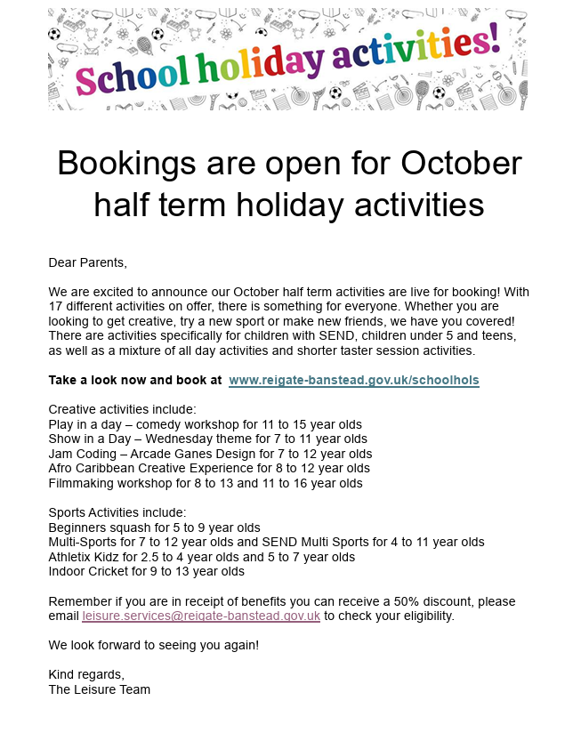
Year 5
Key Dates
Year 6
Key Dates

